Slide 1
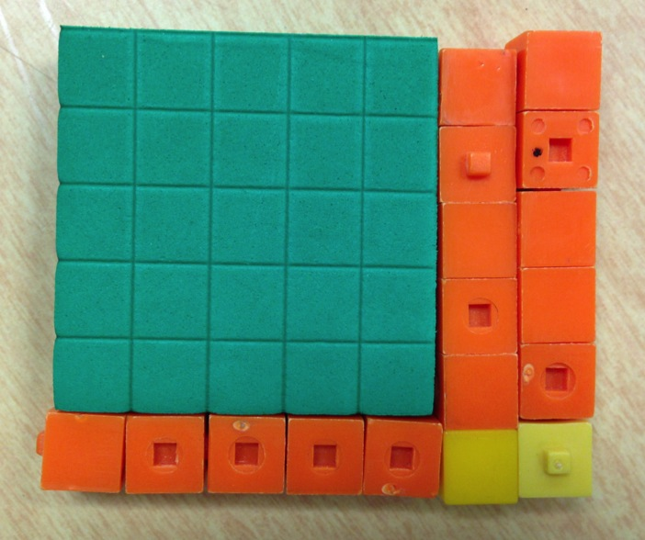
Picturing Multiplication:
5 + 2
from repeated addition
5 + 2
0x7
1x7
2x7
3x7
4x7
5x7
6x7
5 + 2
0
10
20
30
40
50
60
70
5 + 2
to asking for arrays
5 + 2
5 + 2
30 + 12
Larry Francis revised 8/3/16

Slide 4
Multiplication is repeated addition
We define 6 x 7 to mean “6 copies of 7” which equals 7 + 7 + 7 + 7 + 7 + 7
7 + 7 + 7 + 7 + 7 + 7 = 6 x 7
adding 6 copies of 7
(2x7) + (2x7) + (2x7) = 3 copies of (2 x 7)
= 3 copies of (10 + 4)
= (3 x 10) + (3 x 4)
= 30 + 12
3 copies of (2 x 7)

Slide 5
Skip-counting by 7
1 | 2 | 3 | 4 | 5 | 6 | 7 | 8 | 9 | 10
11 | 12 | 13 | 14 | 15 | 16 | 17 | 18 | 19 | 20
21 | 22 | 23 | 24 | 25 | 26 | 27 | 28 | 29 | 30
31 | 32 | 33 | 34 | 35 | 36 | 37 | 38 | 39 | 40
41 | 42 | 43 | 44 | 45 | 46 | 47 | 48 | 49 | 50
51 | 52 | 53 | 54 | 55 | 56 | 57 | 58 | 59 | 60
61 | 62 | 63 | 64 | 65 | 66 | 67 | 68 | 69 | 70
71 | 72 | 73 | 74 | 75 | 76 | 77 | 78 | 79 | 80
81 | 82 | 83 | 84 | 85 | 86 | 87 | 88 | 89 | 90
91 | 92 | 93 | 94 | 95 | 96 | 97 | 98 | 99 | 100

Slide 6
Blank Number Grid
1 | 2 | 3 | 4 | 5 | 6 | 7 | 8 | 9 | 10
11 | 12 | 13 | 14 | 15 | 16 | 17 | 18 | 19 | 20
21 | 22 | 23 | 24 | 25 | 26 | 27 | 28 | 29 | 30
31 | 32 | 33 | 34 | 35 | 36 | 37 | 38 | 39 | 40
41 | 42 | 43 | 44 | 45 | 46 | 47 | 48 | 49 | 50
51 | 52 | 53 | 54 | 55 | 56 | 57 | 58 | 59 | 60
61 | 62 | 63 | 64 | 65 | 66 | 67 | 68 | 69 | 70
71 | 72 | 73 | 74 | 75 | 76 | 77 | 78 | 79 | 80
81 | 82 | 83 | 84 | 85 | 86 | 87 | 88 | 89 | 90
91 | 92 | 93 | 94 | 95 | 96 | 97 | 98 | 99 | 100

Slide 7
6 x 7 with fingers
5 + 2
5 + 2
6 x 7 = 6 x (5+2) = (6 x 5) + (6 x 2) = 30 + 12 = 42
5 + 2
5 + 2
5 + 2
5 + 2
30 + 12
= 42

Slide 8
6 x 7 on the number line
7 + 7 + 7 + 7 + 7 + 7 = 6 copies of 7
6 times
7
7
7
7
7
7
21
21

Slide 9
6 x 7 on the number line
representing:
0x7
1x7
2x7
3x7
4x7
5x7
6x7
0
10
20
30
40
50
60
70
decomposing:
0x(5+2)
1x(5+2)
2x(5+2)
3x(5+2)
4x(5+2)
5x(5+2)
6x(5+2)
0
10
20
30
40
50
60
70
re-ordering:
6x5
6x5 + 6x2
0
10
20
30
40
50
60
70

Slide 10
Multiplication as area
Asking for arrays we get
7
7
7
7
7
7
6 copies of 7
Stack these up and get a 6 x 7 rectangle:
6
7

Slide 11
6 x 7 with base 10 blocks (and some base 5)
start with 7 of these
make a 1x7 rectangular array
replace 5x(1x5) with 1x(5x5)
stack up 6 rows
replace 5x(1x5) with 1x(5x5)
replace 5x(1+1) with 2x(5x1)

Slide 12
6 x 7 = 5x5 + 3x5 + 2 = 25 + 15 + 2 = 42
25
10
5
2

Slide 13
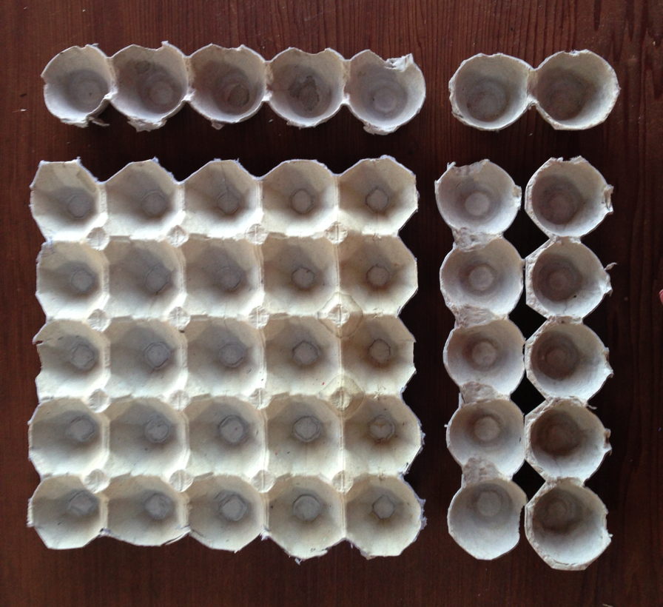
6 x 7 with egg carton arrays
25
10
5
2

Slide 14
6 x 7 on grid paper with 5x5 squares, fives, and ones
(just a blank)
6 x 7

Slide 15
Asking for arrays in arithmetic…
“It’s just Multiplication”
20 + 3
x 10 + 2
40 + 6
200 + 30 + 0
200 + 70 + 6
23
x 12
6
40
30
200
276
build your rectangular array
first, lay out the dimensions then, fill in your rectangle
10
+
2
200
40
20
+
3
30
6
or you can do it schematically (not to scale)

Slide 16
Asking for arrays in algebra…
“It’s just Multiplication”
Recall…
2x + 3
x x + 2
4x + 6
2x² + 3x
2x² + 7x + 6
23
x 12
6
40
30
200
276
build your rectangular array
first, lay out the dimensions then, fill in your rectangle
x
+
2
2x²
4x
2x
+
3
3x
6
or you can do it schematically (not to scale)

Slide 17
Remember to ask for arrays!
Then any division problem is just a multiplication relationship with a missing factor.
? ?
? ?
1 7
3 9 1
1 7
3 9 1

Slide 18
Common Core: key underpinnings for multiplication
2.MD.6. Represent whole numbers as lengths from 0 on a number line diagram with equally spaced points corresponding to the numbers 0, 1, 2, ..., [page 20]
3. (1) Students develop an understanding of the meanings of multiplication and division of whole numbers through activities and problems involving equal-sized groups, arrays, and area models… [page 21]
3. (3) Students recognize area as an attribute of two-dimensional regions. They measure the area of a shape by finding the total number of same size units of area required to cover the shape without gaps or overlaps, a square with sides of unit length being the standard unit for measuring area. Students understand that rectangular arrays can be decomposed into identical rows or into identical columns. By decomposing rectangles into rectangular arrays of squares, students connect area to multiplication, and justify using multiplication to determine the area of a rectangle. [page 21]
3.MD.7 Relate area to the operations of multiplication and addition. a. Find the area of a rectangle with whole-number side lengths by tiling it, and show that the area is the same as would be found by multiplying the side lengths. b. Multiply side lengths to find areas of rectangles with whole number side lengths in the context of solving real world and mathematical problems, and represent whole-number products as rectangular areas in mathematical reasoning. [page 25]
http://www.corestandards.org/wp-content/uploads/Math_Standards.pdf

